Slide 1


Gait Detection GaitStab- Gait stability Assessment
Capstone Project Phase A
25-1-R-7
Supervisor: Dr. Julia Sheidin and Dr. Avital Shulner Tal
Presented by: Lital Leschinsky

Slide 2

Background
Gait
Gait refers to the patterns of human walking, a key indicator of stability, balance, and overall mobility.
Why Analyze Gait?
Gait analysis provides crucial insights into an individual’s health, identifying potential issues such as balance impairments or mobility disorders.

Slide 3
Key Factors Impacting Stability
Physical activity-Engaging in physical activity at varying levels can enhance stability, improve coordination, and support overall mobility.
Gender differences-Men and women exhibit differences in stability, influenced by variations in biomechanics, muscle strength, and movement patterns.
Aging- as individuals age, stability often declines, leading to changes in walking patterns and gait characteristics, which can affect balance

Slide 4
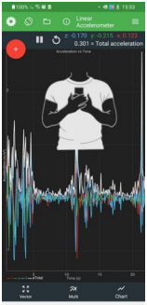
Data Source :Experiment
An experiment was conducted at Ariel University (led by Lihi Deri) to test human gait stability using a smartphone held by subjects.
Data Details: Real-time gait parameters and demographic information (age, gender, BMI, etc.) were collected for 27 participants.

Slide 5

Introduction the problem
Gait detection data is presented in a large, unorganized Excel table.
The format makes it difficult to understand, process, and analyze.
Intuitive visualizations are needed to track stability and balance.
Challenge: Selecting the best graphical representation to highlight trends and anomalies.

Slide 6
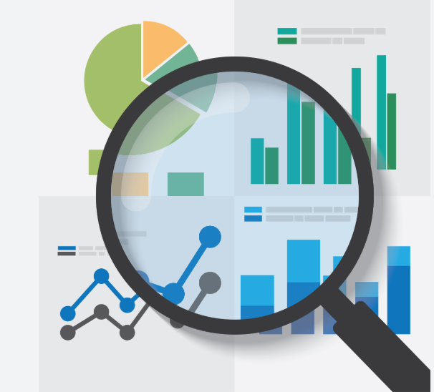
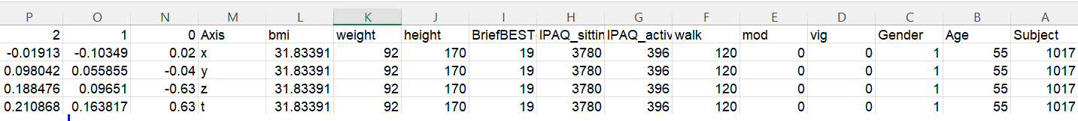
Data Review
Here, we present 4 rows for a single individual. Since we have data for 27 individuals (14 males,13 females), this results in a total of 108 rows.
There are 2,033 columns describing the characteristics of each individual, with a primary focus on their walking progression.

Slide 7
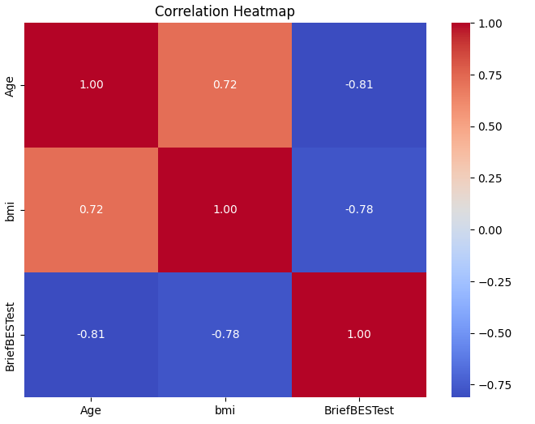
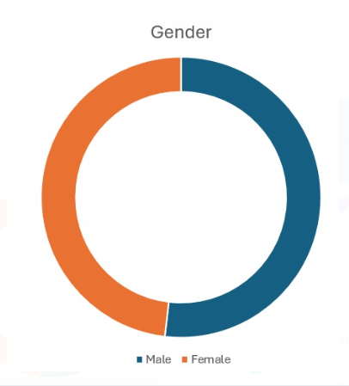
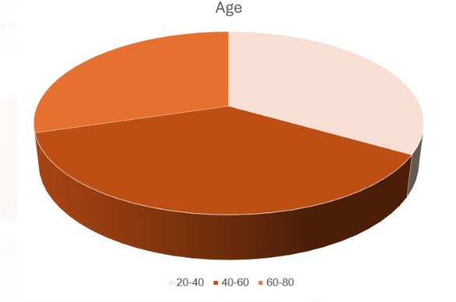
Data distribution
The chart displays the distribution of participants by gender, with 14 males and 13 females, providing a visual understanding of the data composition.
The chart shows the distribution of participants across three age groups: 20-40, 40-60, and 60-80
This graph visualizes the correlations between numerical variables such as Age, BMI, and BriefBESTest scores. A higher positive correlation (closer to 1) means the variables increase together, while a strong negative correlation (closer to -1) indicates an inverse relationship.

Slide 8
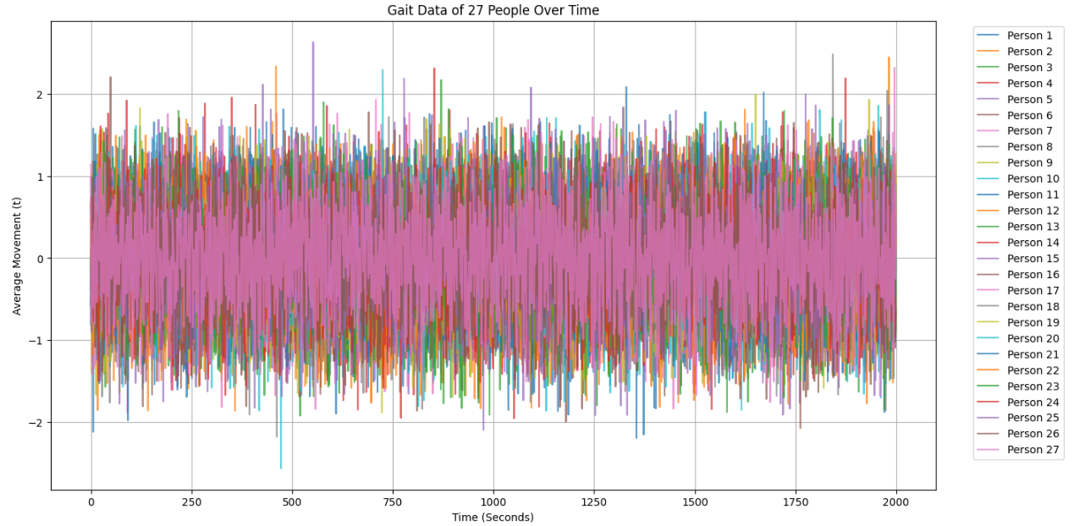
Illustrating the problem
This graph shows gait detection data from 27 participants over time but makes it hard to draw conclusions.

Slide 9
Visualizing Gait Changes Over Time
Time-evolving visualizations help us analyze how walking patterns change over time.
These visualizations track gait , highlighting trends, variations, and anomalies.
They provide a clear representation of movement, making it easier to identify stability changes.
By using this approach, we gain valuable insights into gait behavior

Slide 10

Challenges
Large and diverse dataset
Changes over time
Difficulty in displaying data for 27 people simultaneously
Choosing the visualization that will present the data clearly

Slide 11
Project Objective
Present data through visualizations over time.
Show how individuals compare to others.
Visualize data by grouping individuals into relevant categories.
Present in a clear and understandable way.

Slide 12

Visualization Strategy and Development
A single graph is not enough to fully understand the data.
A dashboard will be used to integrate various visualizations for a comprehensive view.
At this stage, we have not yet selected the final visualizations.
So far, we have created initial graphs using Colab as a starting point for further analysis.

Slide 13
Tools and Architecture for Visualization
Explored D3 and Tableau for graph and visualization capabilities.
Chose Tableau for the next phase due to its ease of use and advanced features.
Tableau Desktop integrates well with Excel and supports creating interactive visualizations for data analysis.

Slide 14
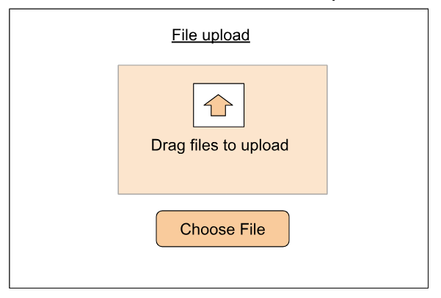
GaitStab- Gait stability Assessment

Slide 15
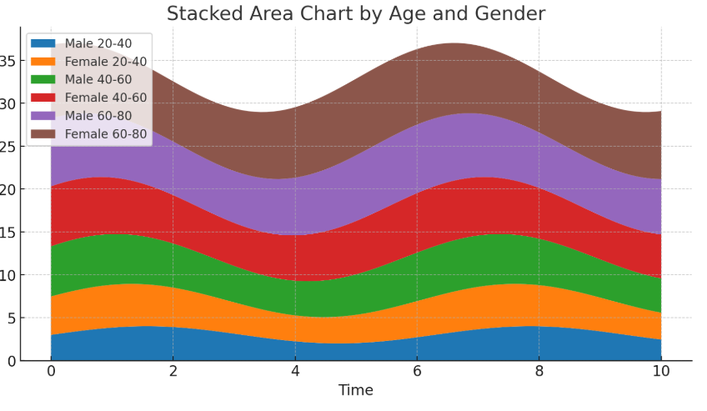
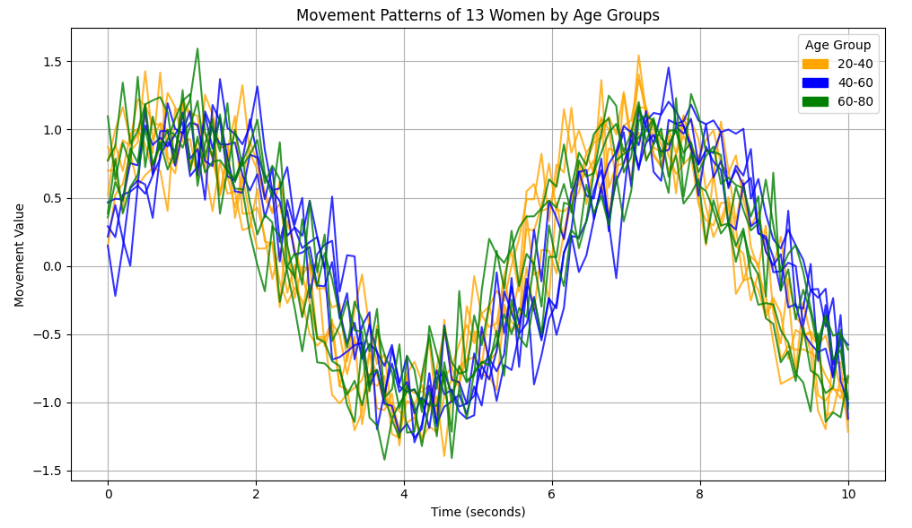

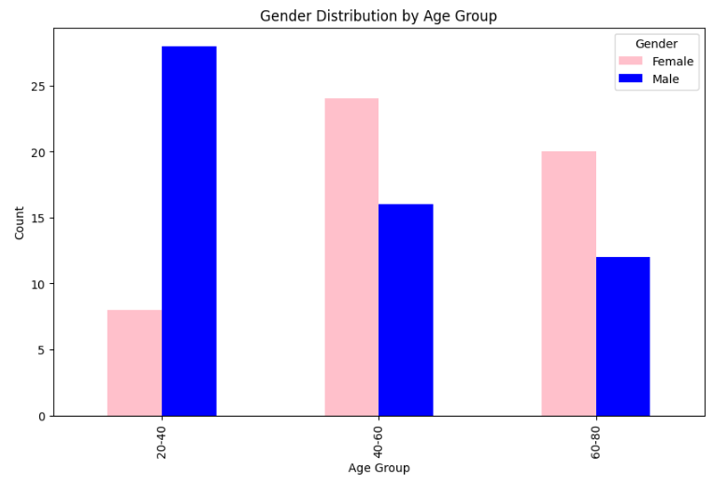
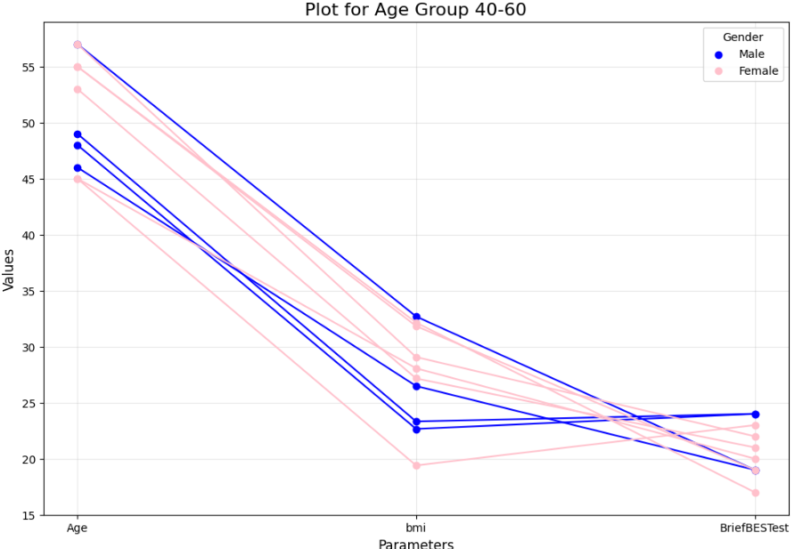
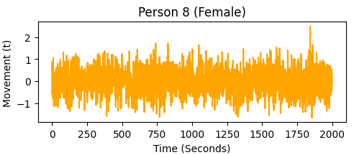
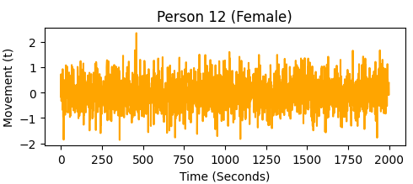
File size: 2599KB number of rows:108 number of columns: 2033
Gender
Male
Female
Age
20-40
40-60
60-80
Gender
Male
Female
20-40
40-60
60-80

Slide 16
Evaluation
Presenting graphs to participants to assess clarity and understanding and evaluating how effectively the data supports interpreting walking patterns and stability.
We will conduct tests to ensure that the data is fully represented in the graphs.

Slide 17

Thanks for listening

